Slide 1
Intro to Machine Learning Project
By Sakada and Shefali

Slide 2
Project Objective
01
Determine whether a restaurant will be successful if it is located near a college campus
02
Various factors that impact the business of a restaurant such as location, ratings, reviews, price, food, ambience
03
Predict the success or the failure of a potential restaurant based on its proximity to a college campus

Slide 3
Our Approach
Used two different datasets
A list of all the colleges in the US
Yelp dataset - list of all the restaurants in the US
College Dataset
id, name, longitude, latitude
Restaurant Dataset
business_id, longitude, latitude, review count, stars
Calculate the distance for each restaurant to the nearest 5 college campuses
Used Geopy python package
Used Machine Learning tools and techniques to determine relationship between rating of a restaurant and its proximity to college campus

Slide 4
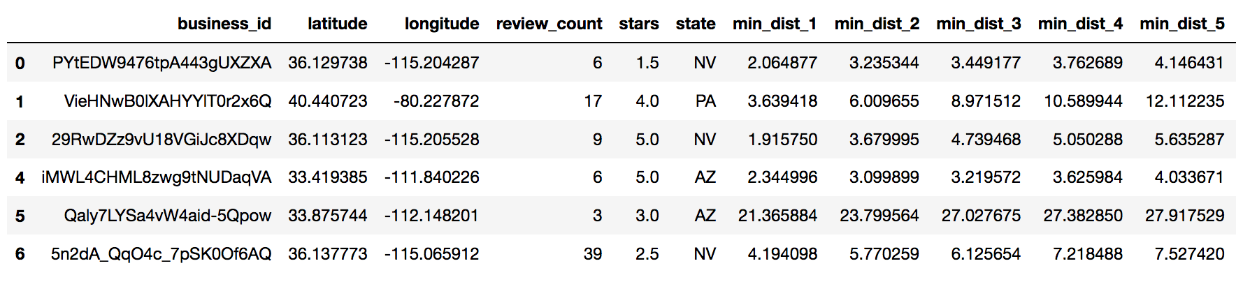
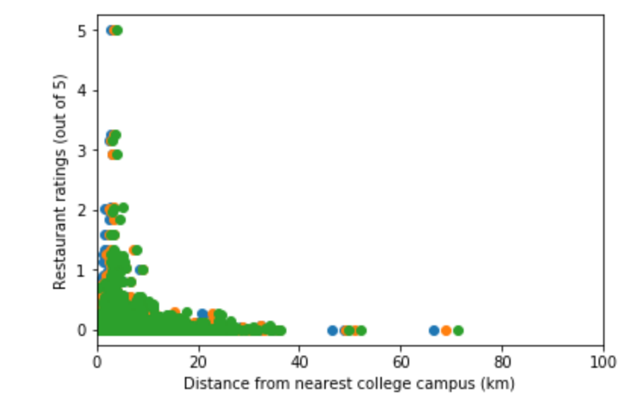

Slide 5
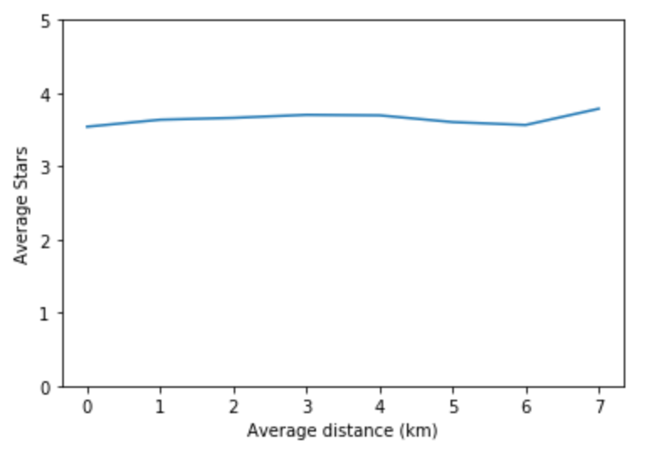
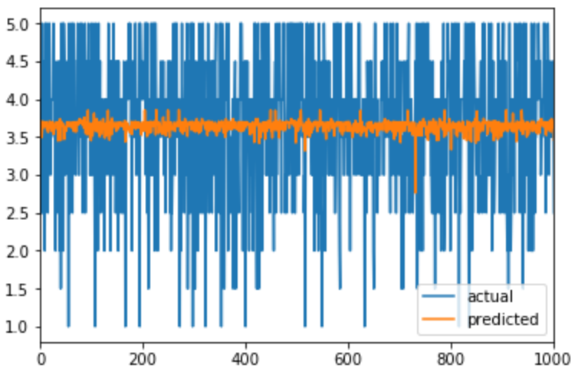
Results

Slide 6
Thank you for listening to our presentation!

